Slide 1
Lab 6 - Windowing
Brian Worts and Chris Jenson

Slide 2
Introduction
This lab used the paper by Harris on the application of the DFT for studying sinusoidal signals. Windowing is used because we trying to take the DFT of a finite length sequence even though sine waves have infinite durations.
Windowing isolates a segment of data and then only multiples that segment by the window function values. The part that is left is the part where they overlap, thus the window.
The method of windowing changes the frequency content of the signal because of spectral leakage. Spectral leakage is caused by a non-integer number of periods. Different methods distribute the leakage spectrally in different ways based on the current needs of the application.
Notes:
Chris
(about 3 minutes) Brief overview of the topic(s) studied in this exercise. Describe the effect of windowing, and why some windows are better than others.

Slide 3

Procedure
The team started by creating a test signal composed of the sum of two cosine waves:
The sequence was made for 200 samples
The FFT was computed
The FFT magnitude was plotted as db vs. bins 0-100
The results were compared to Fig. 58 in the Harris Paper
A poor and a well functioning window were recreated
The impact of noise was examined
Notes:
Brian
(1 minute max) A very brief description of the procedures followed.

Slide 4
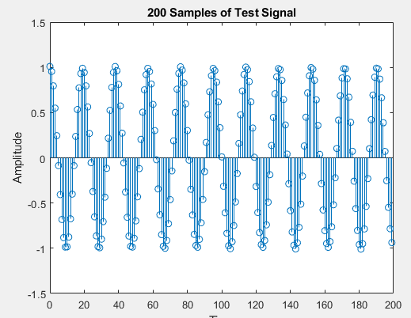
Results: Part 1&2 Waveform
Notes:
Brian
present all plots with informative, highly descriptive captions, describe why you chose the particular high-performing window function

Slide 5
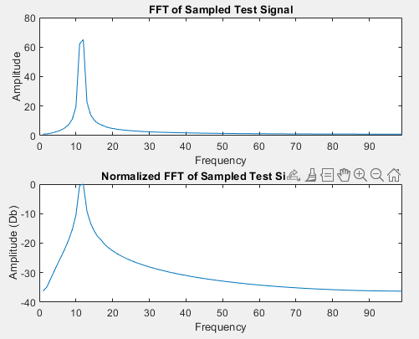
Results: Part 3&4 FFT
Notes:
Brian
present all plots with informative, highly descriptive captions, describe why you chose the particular high-performing window function

Slide 6
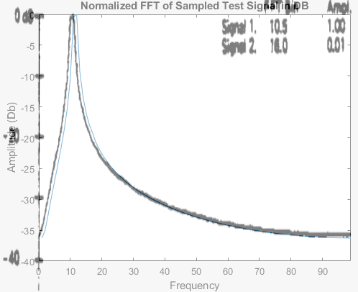
Results: Part 5
This is Figure 58 overtop our results. We found that our normalized FFT of the sampled signal very closely resembles Fig 58.
Notes:
Brian
present all plots with informative, highly descriptive captions, describe why you chose the particular high-performing window function

Slide 7
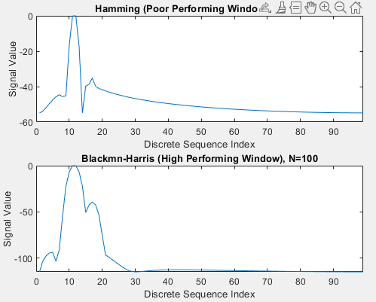
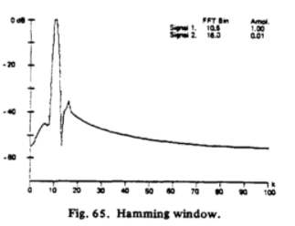
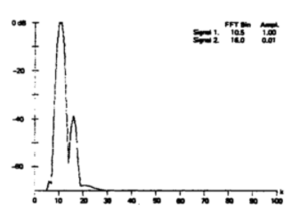
Results: Part 6 Windows
We choose to do the Blackman-Harris window for the high performing window because, according to Harris, it is near equivalent to the other high performance windows while demonstrating minor performance advantages.
It can be defined by a few easily generated coefficients and can be applied as a spectral convolution after the DFT
Notes:
Brian
present all plots with informative, highly descriptive captions, describe why you chose the particular high-performing window function

Slide 8
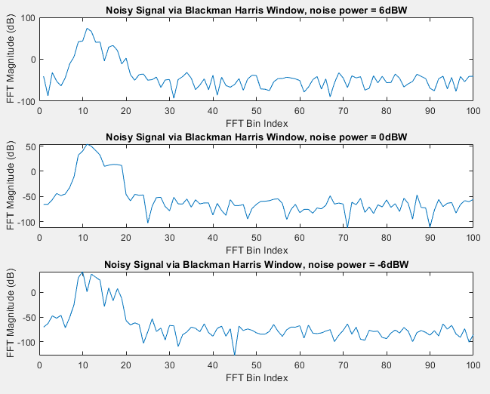
Results: Part 7 Noise
Applying noise to the signal shows a clear impact to the FFT magnitude of the signal.
Notes:
Chris
examine the impact. You might try power values of 0 dBW, or 6 dBW, or -6 dBW.

Slide 9
Knowledge Gained
This lab gave us a better understanding of the effect that sample size has on discrete Fourier analysis, as well as the concept of windowing and how choosing the best window can lead to better results through the analysis of Fredric J. Harris’ paper on the use of windows in discrete Fourier analysis.
By multiplying discrete signal data by a window function, we are able to model finite sample data composed of infinite duration sine waves which we can perform analysis on. This is a useful skill for filter design.
Applying noise to the Blackman-Harris window showed how the window processes varying levels of noise. Spectral analysis distributes the noise components which improves the signal to noise ratio. Our windows also show the impact on the magnitude of the signal.
Notes:
Chris

Slide 10
Who Did What
Student | Analysis | Development | Coding | Results | Writing
Brian | 50 | 40 | 60 | 50 | 50
Chris | 50 | 60 | 40 | 50 | 50

